Slide 1
Horizontal Stiffness and Natural frequency Comparison of a pier-pilecap using Q3 and Q4 elements
Presented by:
1.Usayed Islam(20105062)
2.Lamia Ahmed Sadia(20105084)
Presented to:
Dr. Iftekhar Anam
Professor,
Department of Civil Engineering,
University of Asia Pacific

Slide 2
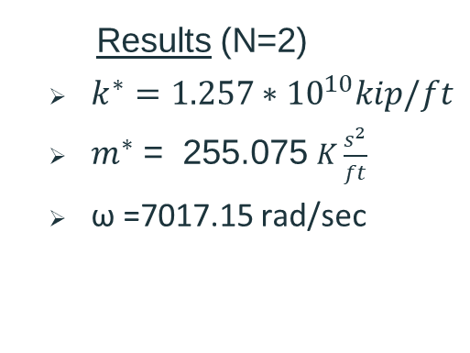
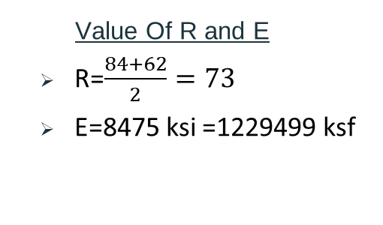
Manual Calculation
Value Of R and E
R=$\frac{84+62}{2}=73$
E=8475 ksi =1229499 ksf
Results (N=2)
$k^{∗}=1.257∗{10}^{10}kip/ft$
$m^{∗}$ = 255.075 $K\frac{s^{2}}{ft}$
ω =7017.15 rad/sec

Slide 3
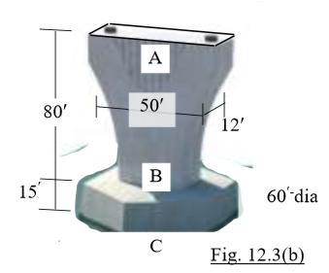
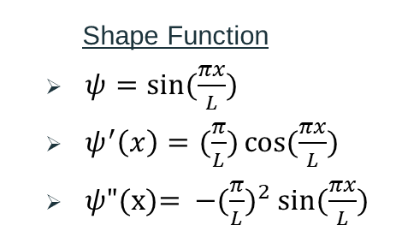
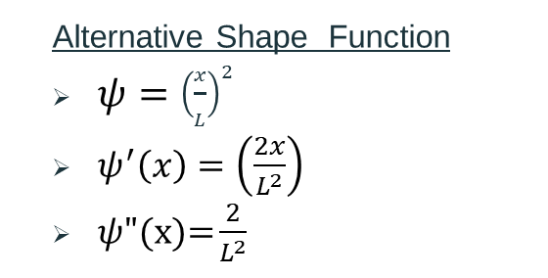
Manual Calculation
Shape Function
$ψ=\sin{(\frac{πx}{L}})$
$ψ^{′}\left(x\right)=(\frac{π}{L})\cos{(\frac{πx}{L})}$
$ψ"\text{(}\text{x}\text{)= }{−(\frac{π}{L})}^{2}\sin{(\frac{πx}{L}})$
Deflection ≠0,
Rotation ≠0
Alternative Shape Function
$ψ={\left(\frac{x}{L}\right)}^{2}$
$ψ^{′}\left(x\right)=\left(\frac{2x}{L^{2}}\right)$
$ψ"\text{(}\text{x}\text{)=}\frac{2}{L^{2}}$
Deflection =0,
Rotation =0

Slide 4
Software Exploited
01
Etabs
02
Staad Pro
Q4 Elemets calculation has been done using this software
Triangular Element calculation has been done using this software

Slide 5
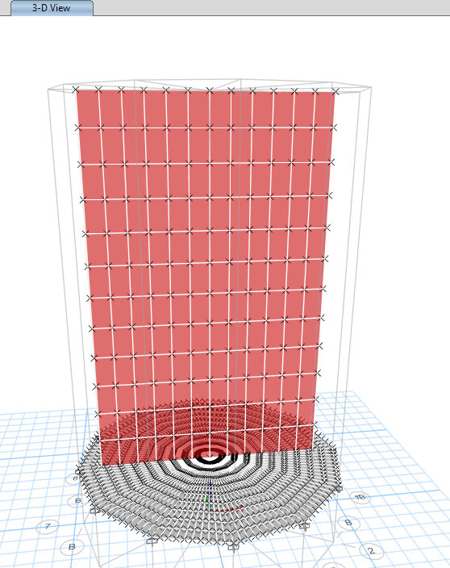
Etabs
In Etabs, a triangular mesh can be created in a rectangular section. Since this section is circular, triangular meshing is not possible.

Slide 6
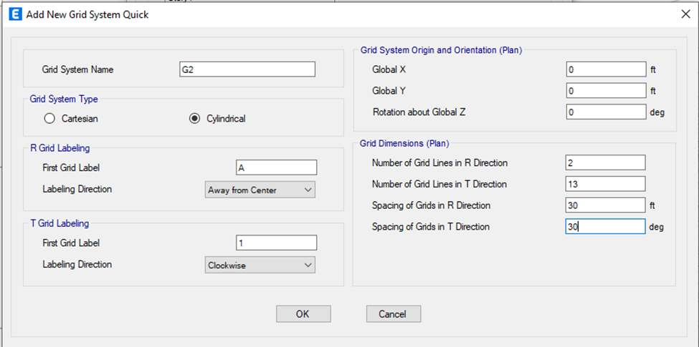
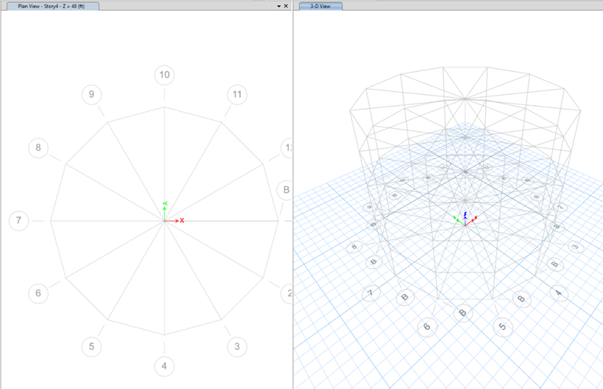
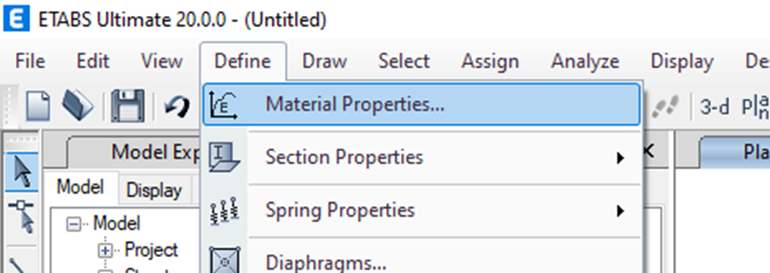
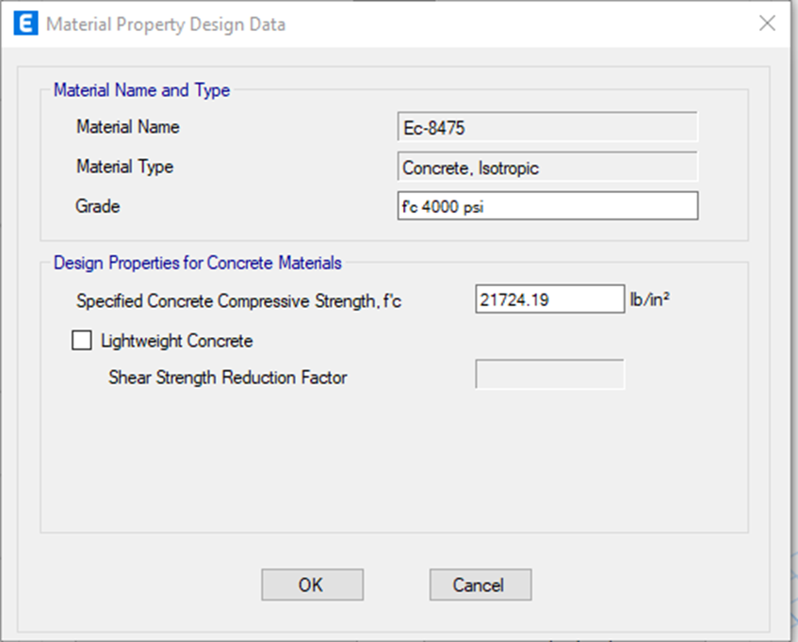
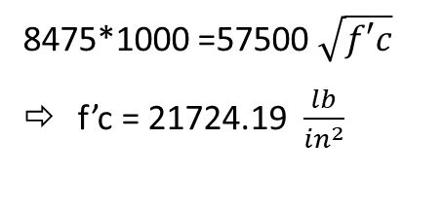
Project-01
Dimension Tab
Material properties Define
8475*1000 =57500 $\sqrt{f′c}$
f’c = 21724.19 $\frac{lb}{{in}^{2}}$

Slide 7
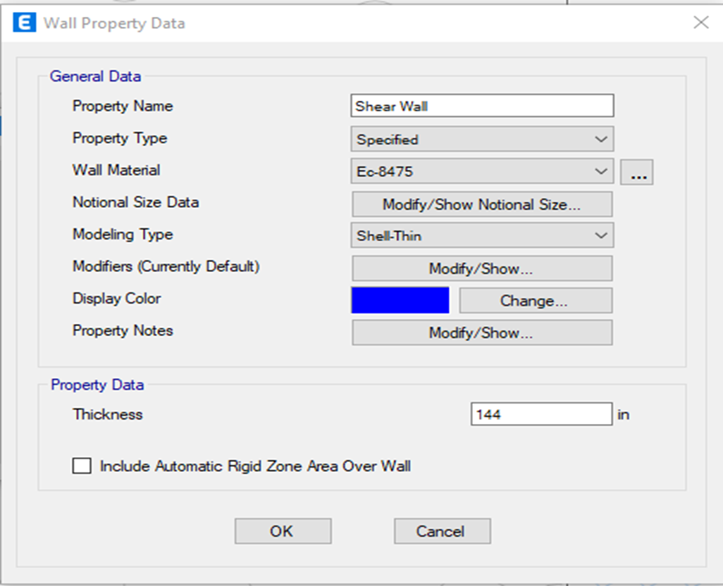
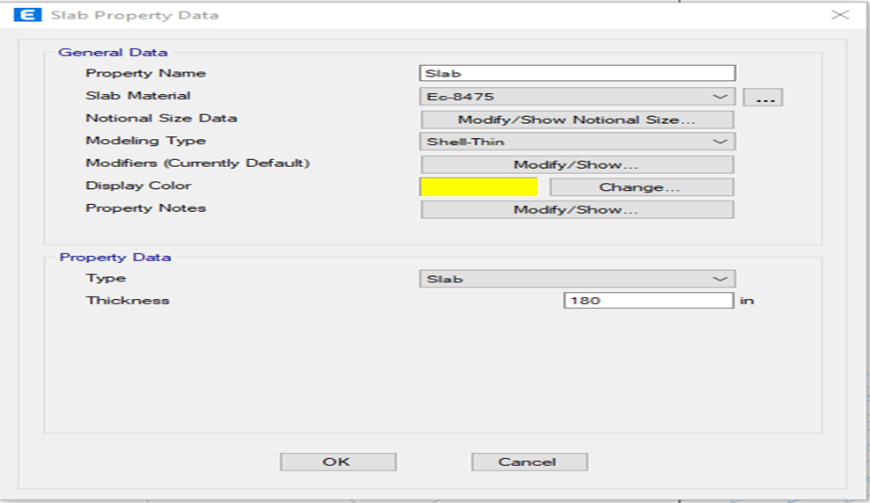
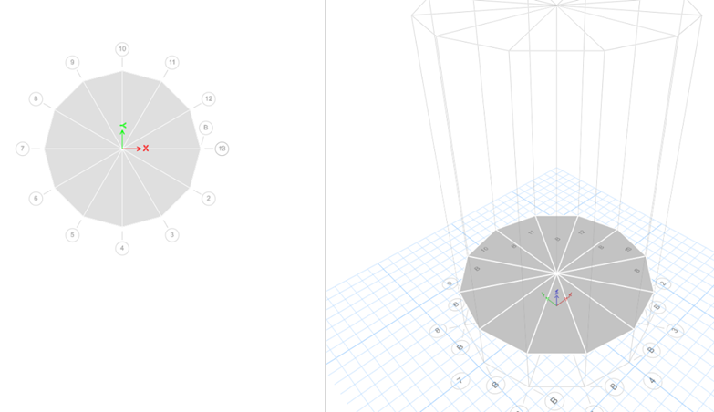
Steps of Project-o1
ETABS automatically defines column meshes. Manual definition for multiple elements is not available. Therefore, consider modeling each part as a shear wall.
Slab Section
Thickness=15*12=180
Thickness=12*12=144

Slide 8
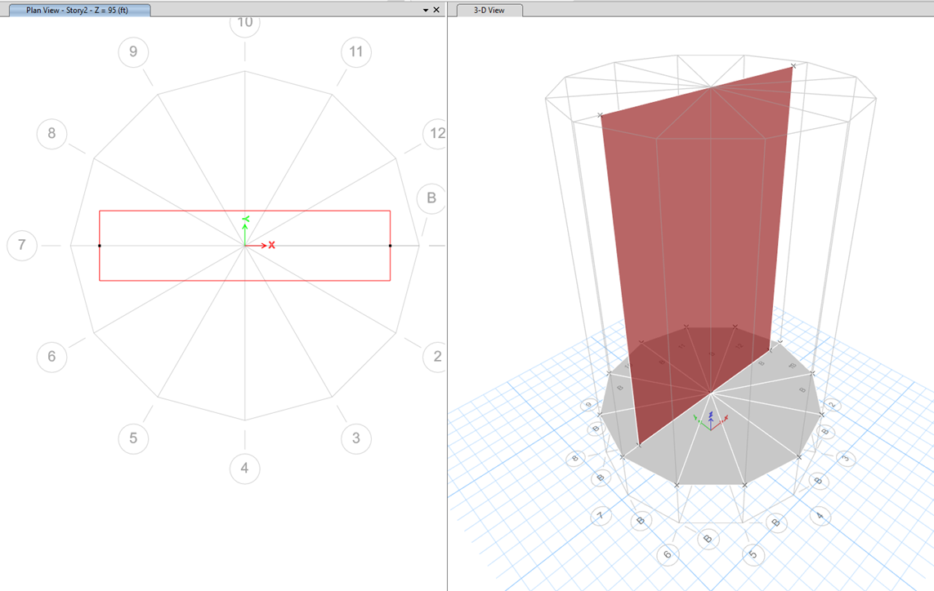
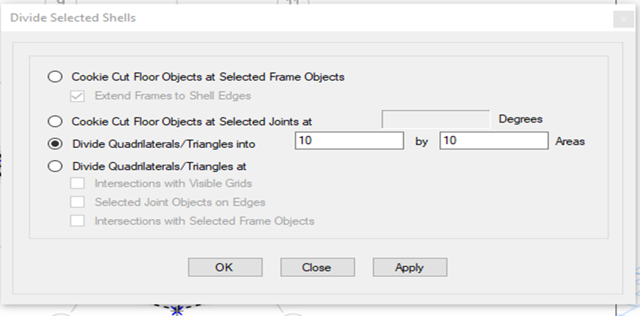
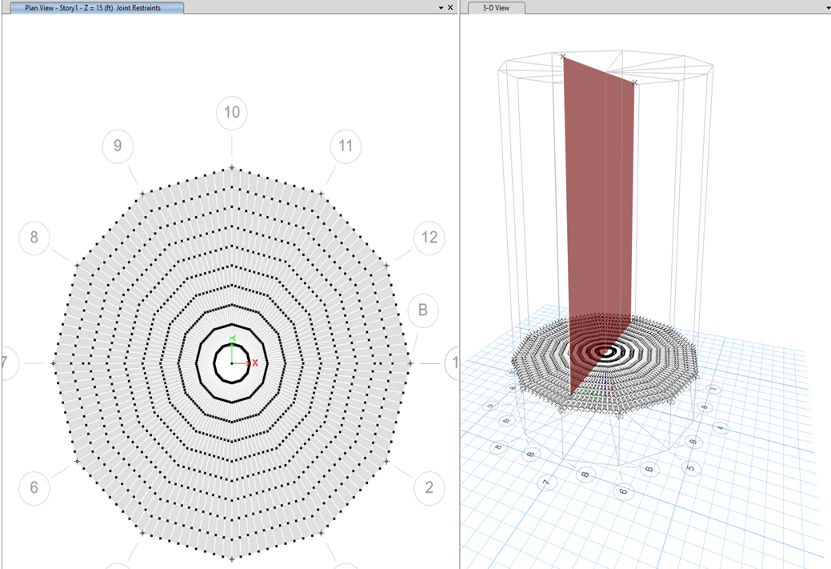
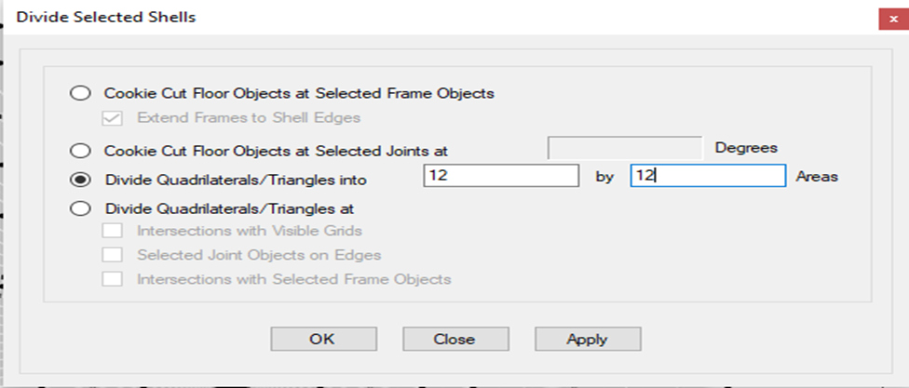
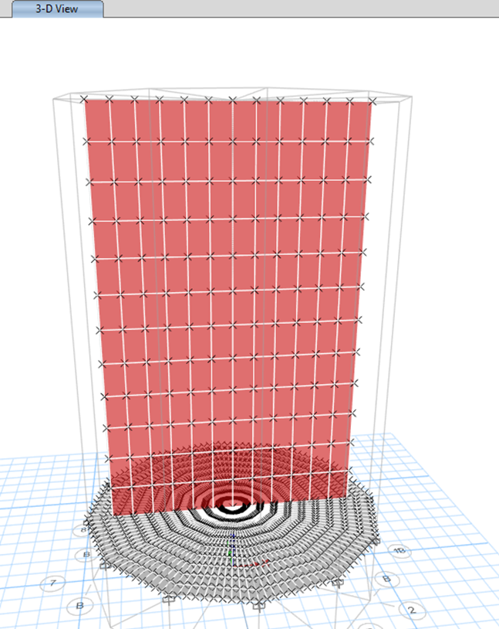
Steps of Project-o1
Shear Wall
Slab Mesh
Shear Wall Mesh

Slide 9
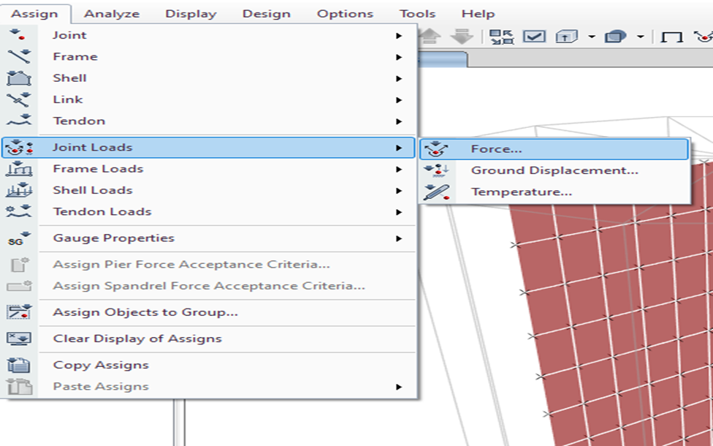
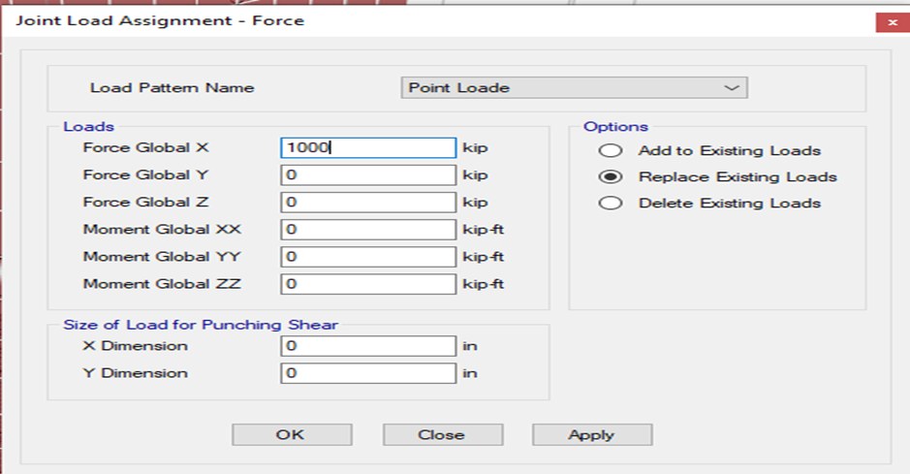
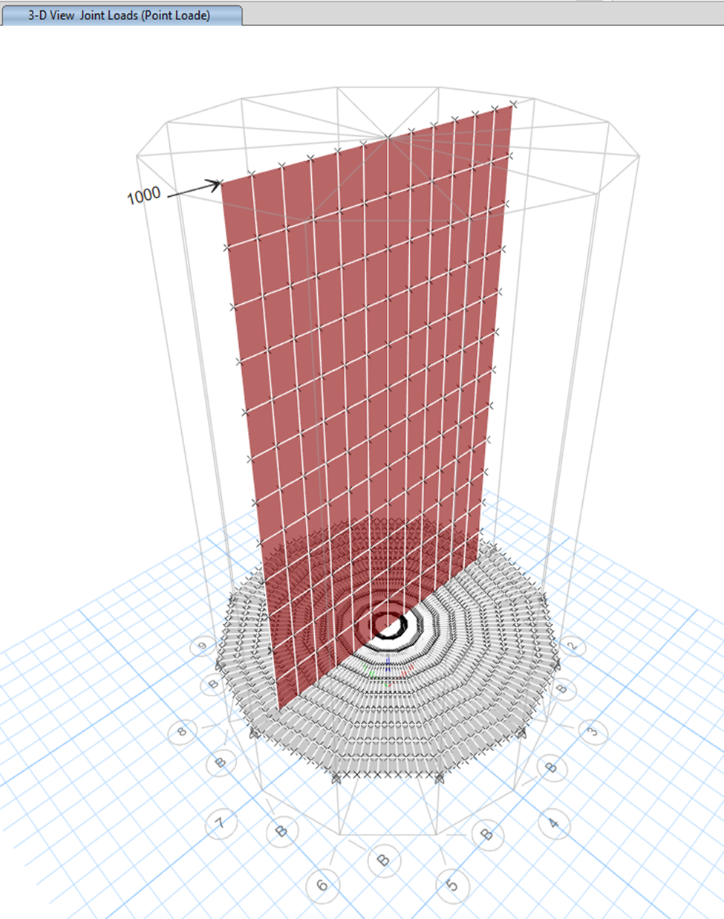
Steps of Project-o1
Load Assigned
3d Model

Slide 10
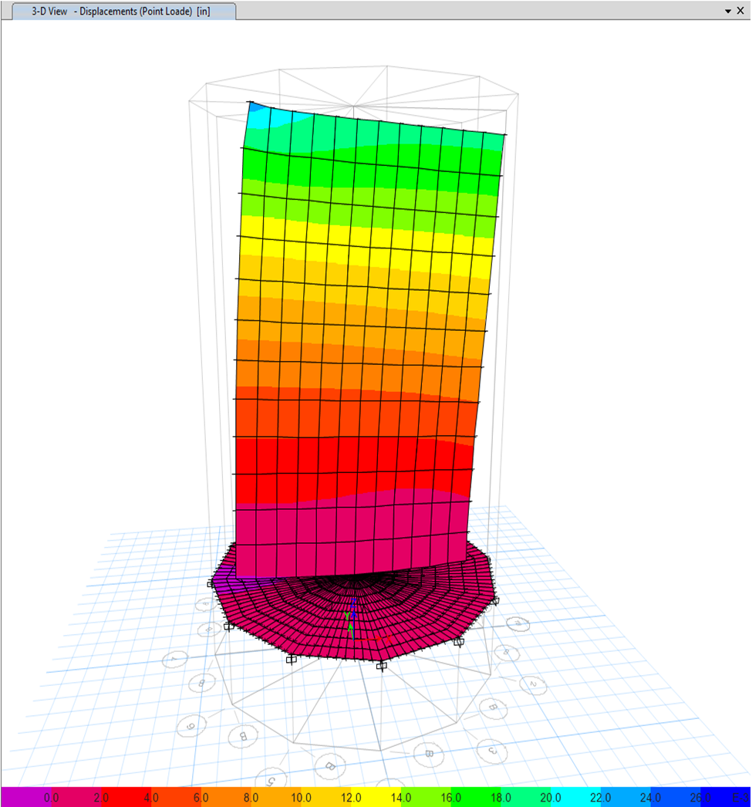
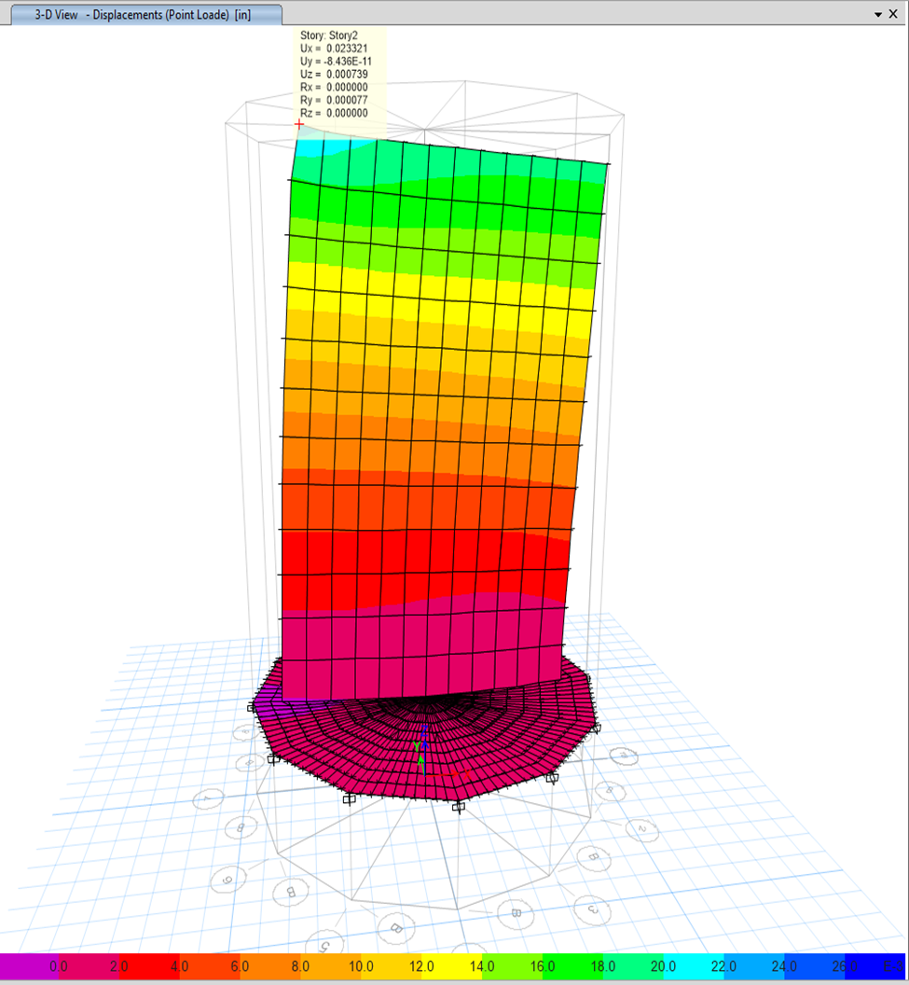
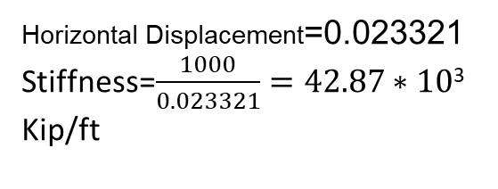
Steps of Project-o1
Horizontal Displacement=0.023321
Stiffness=$\frac{1000}{0.023321}=42.87∗10$³ Kip/ft
3D View After Analysis
Horizontal Displacement

Slide 11
Result Comparison(Project-01)
Manual Calculation | Etabs Analysis
1.257*10¹⁰ k/ft | 42.87*10³k/ft
The Variation is huge because in Etabs we do not include Axial forces (self-weight of span). Only a horizontal force of 1000 k has been added because of the limitation of Etabs.

Slide 12
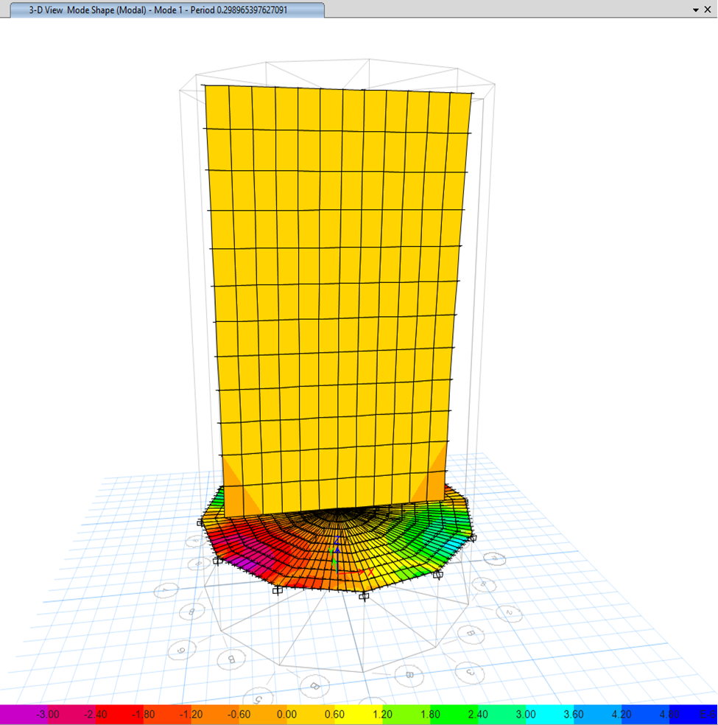
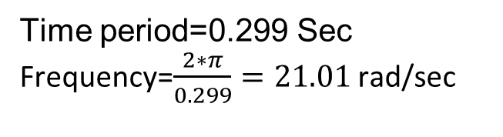
Project-02 Steps of Project-02
Time period=0.299 Sec
Frequency=$\frac{2∗π}{0.299}=21.01$ rad/sec
Etabs Model in Mode-1

Slide 13
Result Comparison(Project-02)
Manual Calculation | Etabs Analysis
7017.15 rad/s | 21.01 rad/s
In Etabs Horizontal stiffness was different than manual calculation so, the natural frequency also varies and inaccuracy occurs.

Slide 14
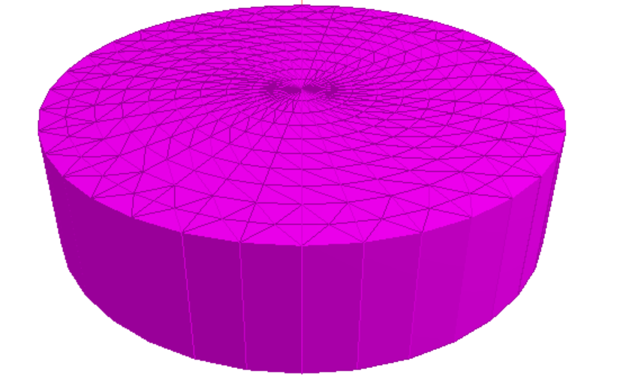
Triangular Elements for Pile cap
Staad Pro
Pile Cap not perfectly circular
The continuous 10 degree triangle makes that pile-cap

Slide 15

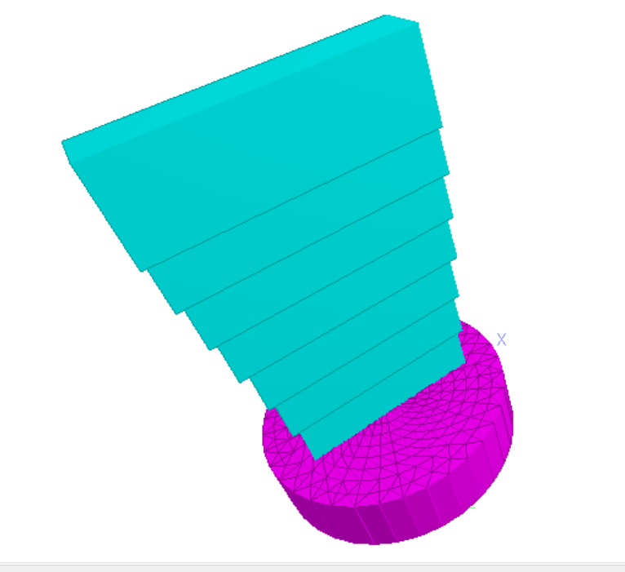
Pile and Pilecap
The cross-section of the pile gradually increases.
10 layer of different cross section.

Slide 16
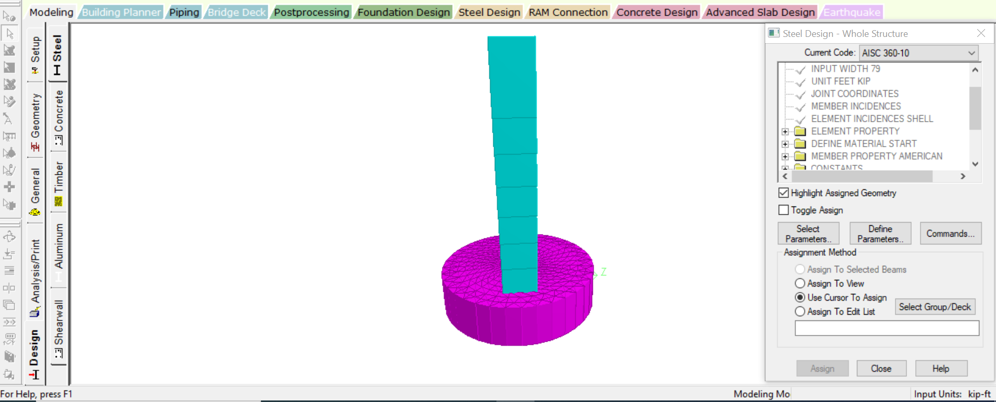
3D view of Structure
The pile volume remains same
Pile cap volume varies.

Slide 17
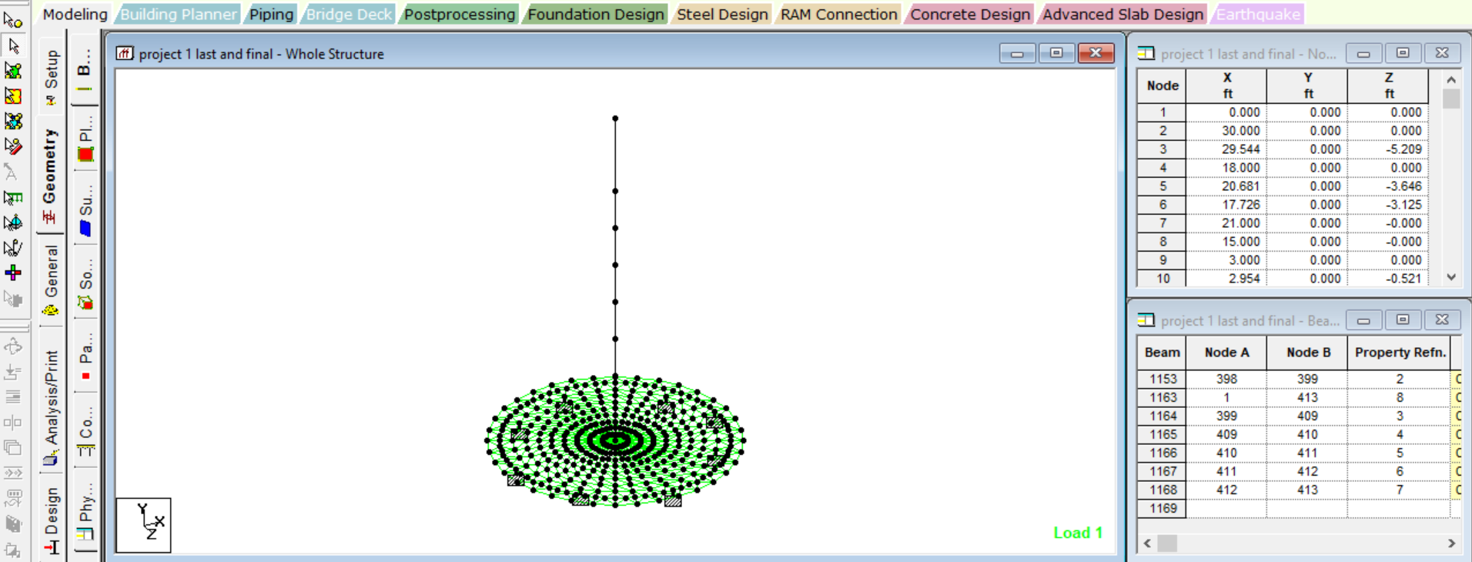
Nodes of pile-cap
01
Pile
8 nodes
02
Pile Cap
405 nodes

Slide 18
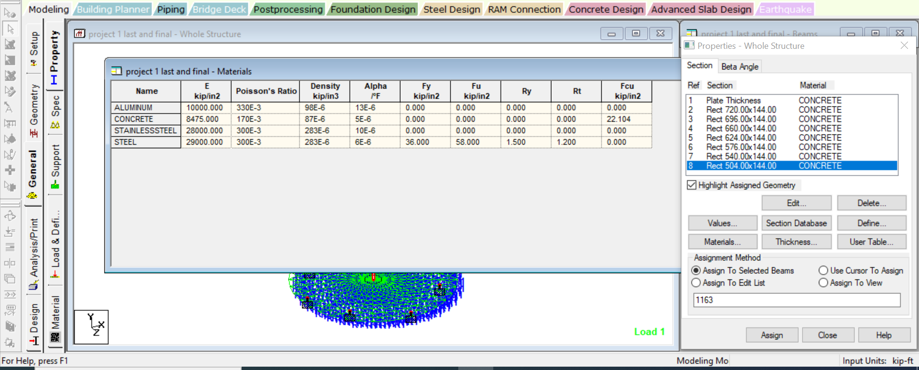
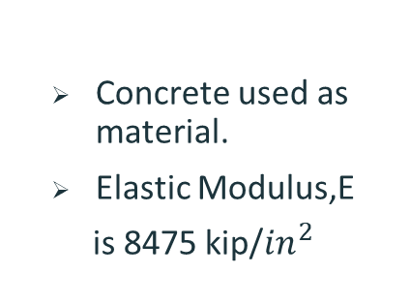
Material Properties
Concrete used as material.
Elastic Modulus,E
is 8475 kip/${in}^{2}$

Slide 19
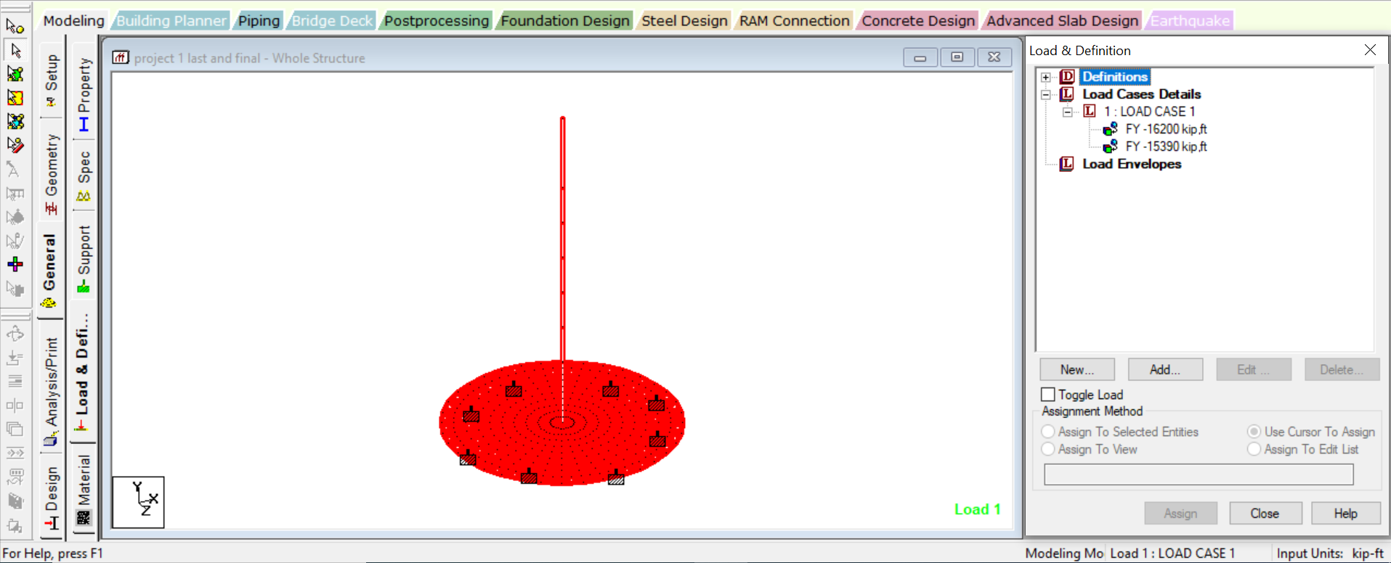
Assigned loads
Slab weight
16200 kip/ft
15490 kip/ft
Pile cap weight

Slide 20
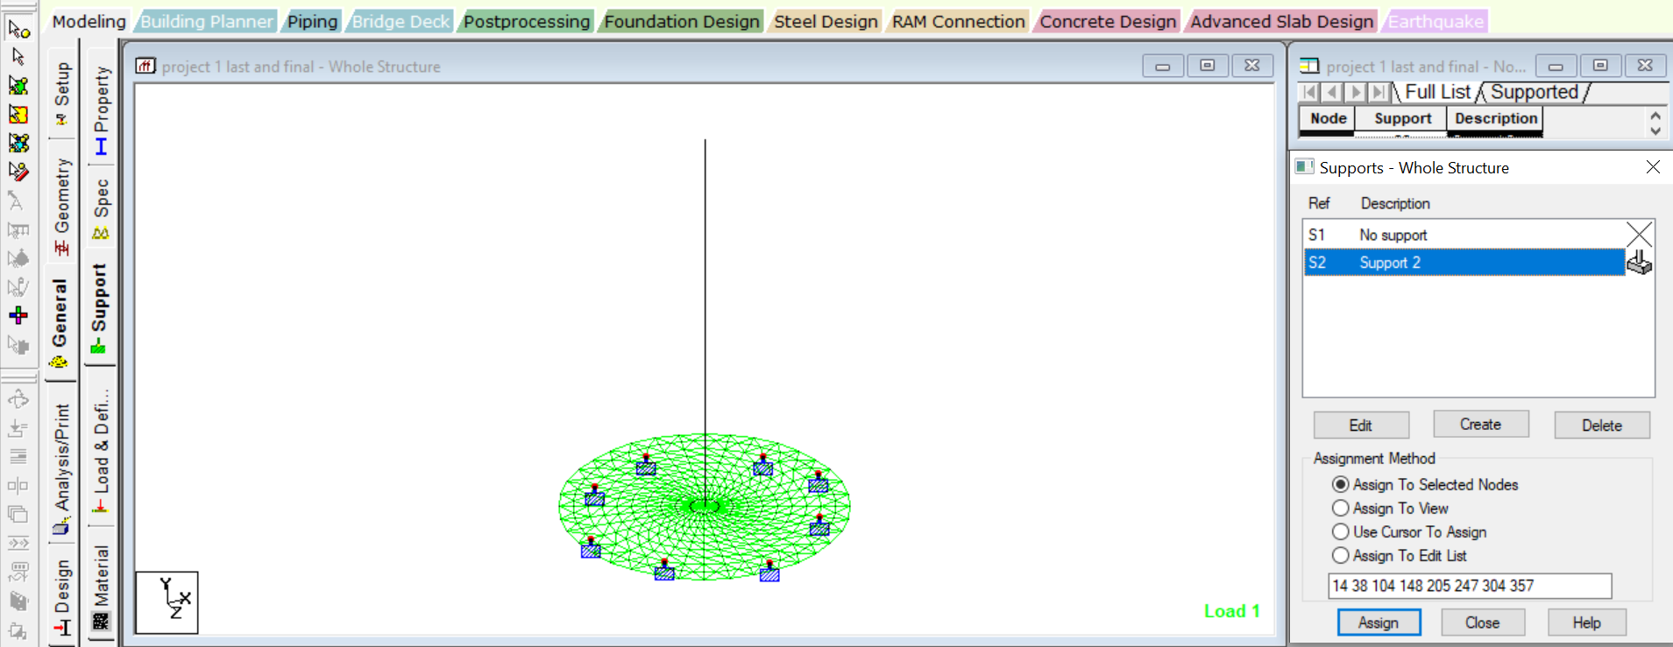
Supports
8 Fixed Supports provided
Placements were symmetric

Slide 21
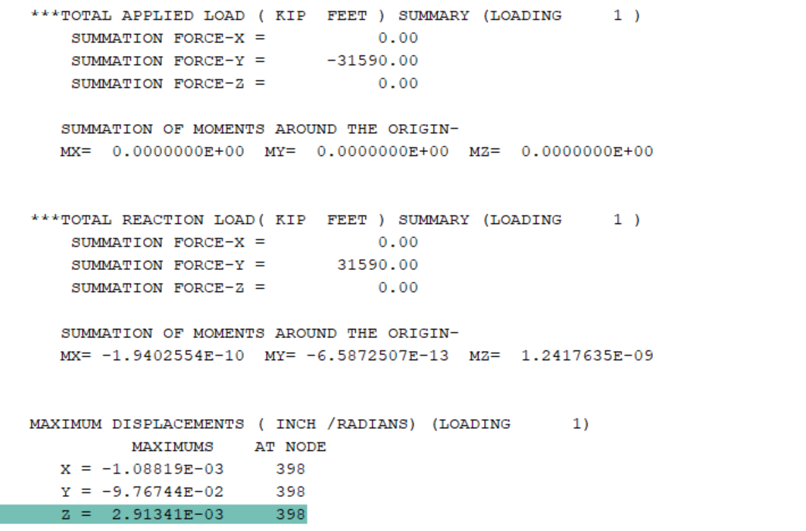
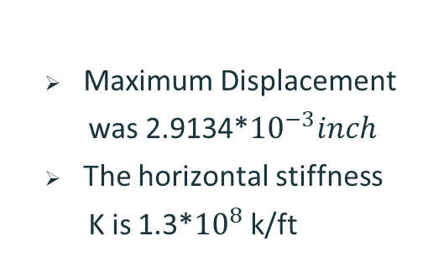
Analysis Data
Maximum Displacement
was 2.9134*${10}^{−3}inch$
The horizontal stiffness
K is 1.3*${10}^{8}$ k/ft

Slide 22
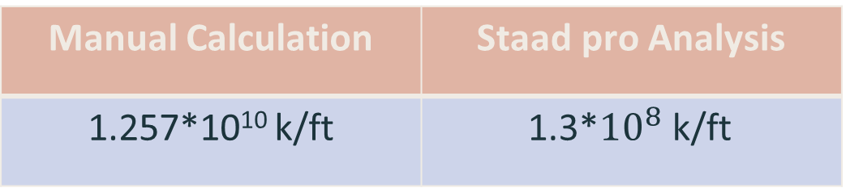
Result Comparison(Project-01)
Manual Calculation | Staad pro Analysis
1.257*10¹⁰ k/ft | 1.3*${10}^{8}$ k/ft
There is variation because Staad pro cannot mesh a vertical member(pile) properly. Inaccuracy of Shape function can differ the result also.

Slide 23
Thank You!
Does anyone have any questions?

